Slide 1

IST 402 Network Security DES LM5
Joe Oakes
Penn State Abington

Slide 2


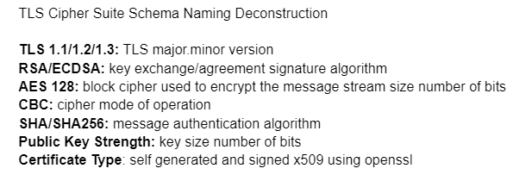
TLS Transport Layer Security
Transport Layer Security methods needed to perform
Key Exchange share a password
Encryption Ciphers
Block Chaining
Hashing check Integrity
Random number generation
Encoding
Certificates
Work with protocols
Work with handshaking

Slide 3
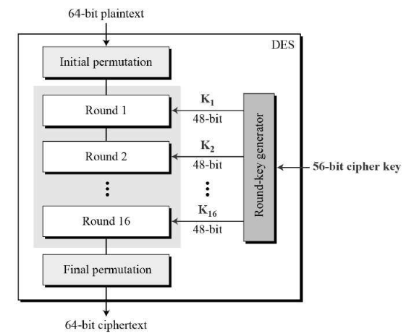
DES: Data Encryption Standard
DES is a symmetric-key block cipher published by the National Institute of Standards and Technology (NIST).
DES is based on the two fundamental attributes of cryptography:
Substitution (also called confusion)
Transposition (also called diffusion)
DES consists of 16 steps, each of which is called a round.
Each round performs the steps of substitution and transposition.

Slide 4
DES: Data Encryption Standard
The plaintext is processed in 64 bit blocks
It uses 16 round Feistel structure
The key is 64 bits but 8 bits are used for parity checks
The effective key is 56-bits in length
The block size for DES is 64 bits
The ciphertext is 64 bit blocks

Slide 5
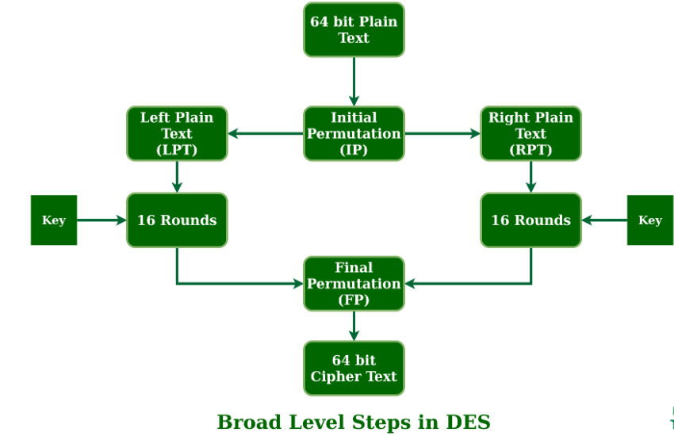
DES: Data Encryption Standard
The initial permutation (IP) produces two halves of the permuted block; saying Left Plain Text (LPT) and Right Plain Text (RPT).
LPT 32 bits
RPT 32 Bits

Slide 6
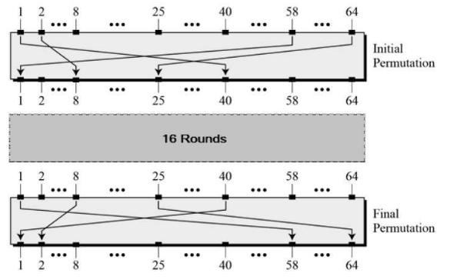
DES: Permutations Initial and Final
The initial and final permutations are straight Permutation boxes (P-boxes) that are inverses of each other.
They have no cryptography significance in DES.
This was implemented for the hardware circuit which receives data over an 8-bit bus to work with shift registers

Slide 7
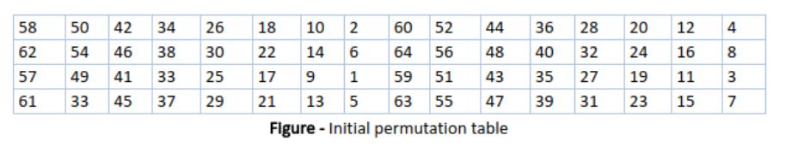
DES: Initial Permutation Table
IP replaces the first bit of the original plain text block with the 58th bit of the original plain text
The second bit with the 50th bit of the original plain text block
It continues on and on for each bit

Slide 8
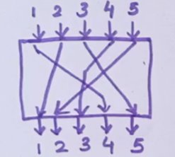
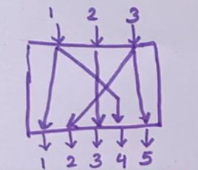
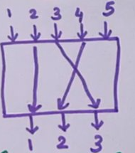
DES: Permutation Boxes
The different types of P-Boxes
Permutations: Straight, Expansion, and Compression
Straight Permutation
In: 5 bits -> Out: 5 bits
Expansion Permutation
In: 3 bits -> Out: 5 bits
Compression Permutation
In: 5 bits -> Out: 3 bits

Slide 9
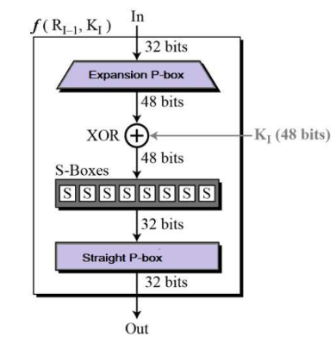
DES: Round Function
The heart of this cipher is the DES function, f.
The DES function applies a 48-bit key to the rightmost 32 bits to produce a 32-bit output.
Expansion and Straight P-Boxes
S-Boxes
Key (48 bits)

Slide 10

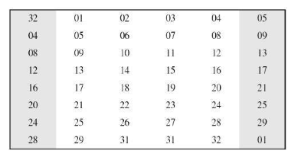
DES: Expansion Permutation Box
In: 4 bits X 8 = 32 bits
Since right input is 32-bit and round key is a 48-bit, we first need to expand right input to 48 bits.
01, 02, 03, 04 in becomes 31, 01, 03, 04, 05
Out: 6 bits X 8 = 48 bits

Slide 11
DES: XOR Operation
After the expansion permutation, DES does XOR operation on the expanded right section and the round key.
Round

Slide 12
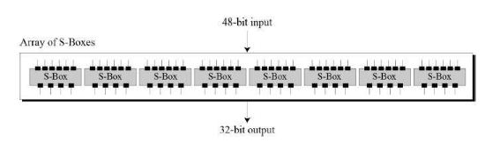
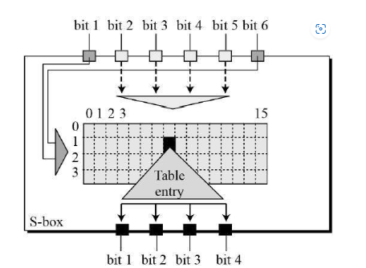
DES: Substitution Boxes S-box
The S-boxes carry out the real mixing (confusion)
DES uses 8 S-boxes, each with a 6-bit input and a 4-bit output.
The output of all eight s-boxes is then combined in to 32 bit section.

Slide 13
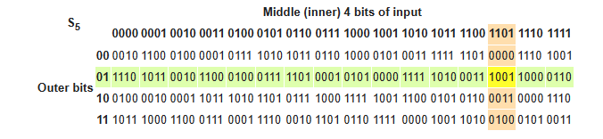
DES: Substitution Boxes S-box
Given a 6-bit input, the 4-bit output is found by selecting the row using the outer two bits, and the column using the inner four bits.
For example, an input "011011" has outer bits "01" and inner bits "1101"; the corresponding output would be "1001".

Slide 14
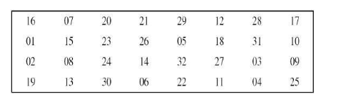
DES: Straight Permutation Box
The 32 bit output of S-boxes is then subjected to the straight permutation

Slide 15
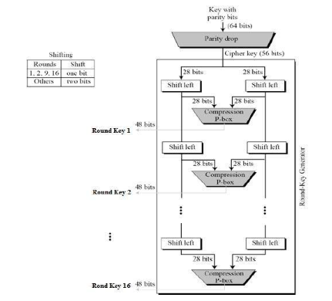
DES: Key Generation
The round-key generator creates sixteen 48-bit keys out of a 56-bit cipher key.

Slide 16
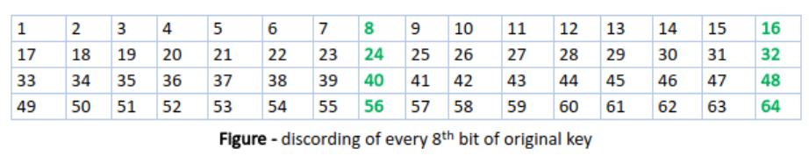
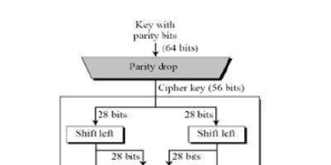
DES: Key Transformation: Parity Drop
The initial key consists of 64 bits.
DES uses a 56-bit key.
Before the DES process even starts, every 8th bit of the key is discarded to produce a 56-bit key.
The 64-bit key is transformed into a 56-bit key by discarding every 8th bit of the initial key.
That is bit positions 8, 16, 24, 32, 40, 48, 56, and 64 are discarded.

Slide 17
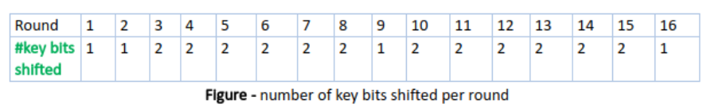
DES: Key Transformation
From this 56-bit key, a different 48-bit Sub Key is generated during each round using a process called key transformation.
For this, the 56-bit key is divided into two halves, each of 28 bits.
These halves are circularly shifted left by one or two positions, depending on the round.
If the round numbers 1, 2, 9, or 16 the shift is done by only one position for other rounds, the circular shift is done by two positions.

Slide 18
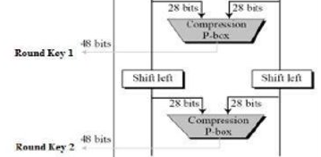
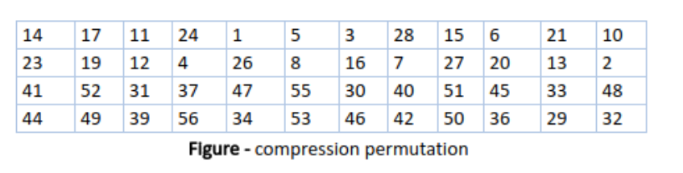
DES: Key Transformation: Step 1: Compression Permutation
From this 56-bit key, a different 48-bit Sub Key is generated during each round using a process called key transformation.
For this, the 56-bit key is divided into two halves, each of 28 bits.
Notice the table only contains only 48-bit positions
Bit number 14 moves to the first position, bit number 17 moves to the second position
Bit number 18 is discarded

Slide 19
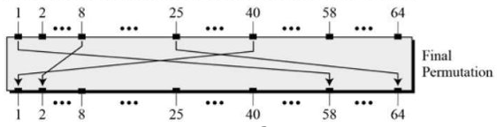
DES: Data Encryption Standard
The final permutation (IP) produces two halves of the permuted block; saying Left Plain Text (LPT) and Right Plain Text (RPT).
LPT 32 bits
RPT 32 Bits

Slide 20
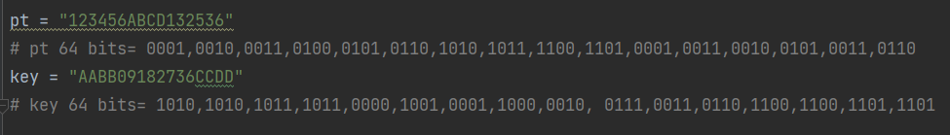

DES: Python Code Review: Plain Text and the Key
The plaintext is processed in 64 bit blocks.
Values shown are Hex values 0-F
So a Hex value of 1 = binary 0001, 2 = 0010, A = 1010, F = 1111
The key is 64 bits but 8 bits are used for parity checks
The block size for DES is 64 bits

Slide 21
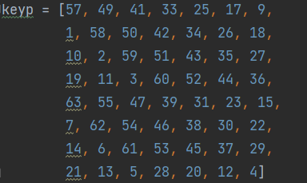
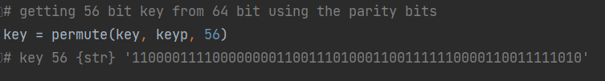
DES: Python Code Review: Key Parity bit drop table
The key is 64 bits but 8 bits are used for parity checks
The effective key is 56-bits in length

Slide 22
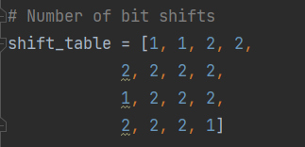
DES: Python Code Review: Key Bit Shift Table
The key is 64 bits but 8 bits are used for parity checks
The effective key is 56-bits in length

Slide 23
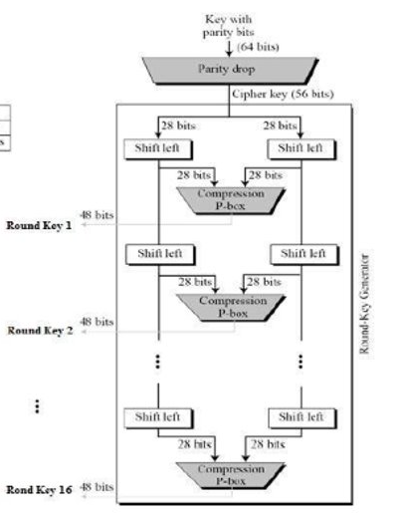
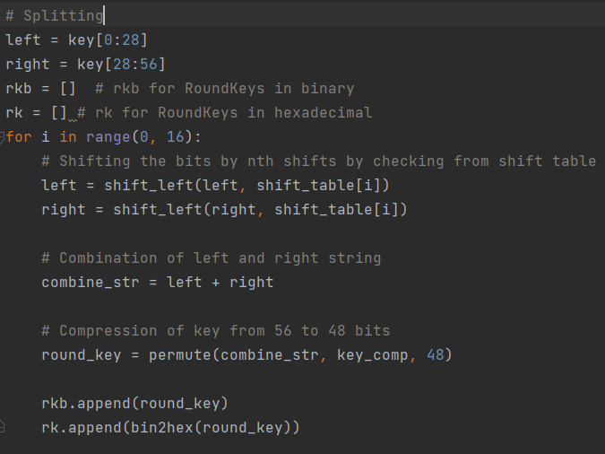
DES: Python Code Review: Key Splitting and Shifting

Slide 24
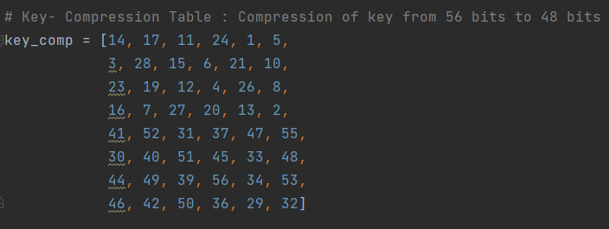

DES: Python Code Review: Key Compression Permutation
Compression Permutation from 56-bits in length to 48 bits

Slide 25
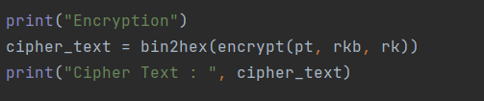
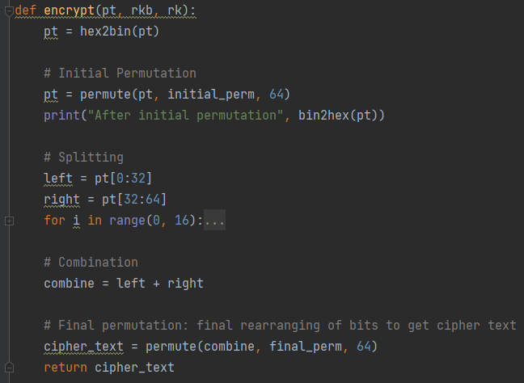
DES: Python Code Review: Encryption Method

Slide 26
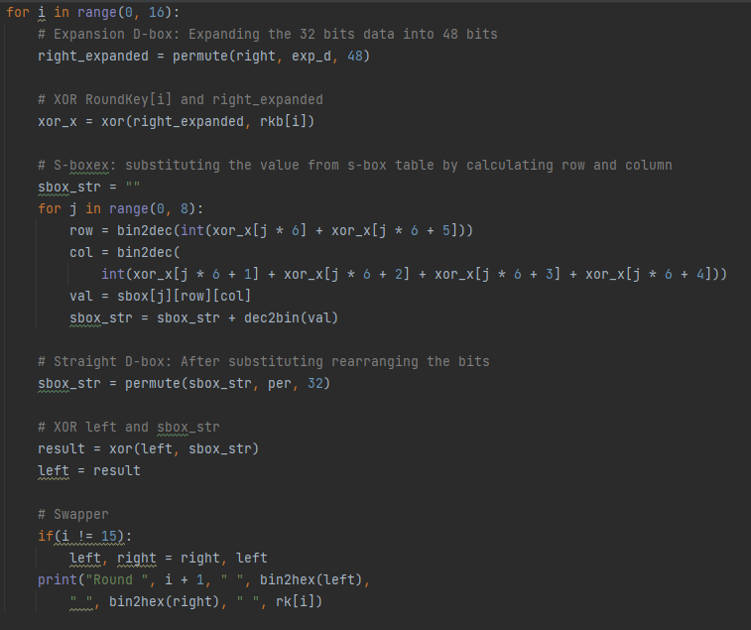
DES: Python Code Review: 16 Rounds

Slide 27
DES: Python Code Review: 16 Rounds

Slide 28
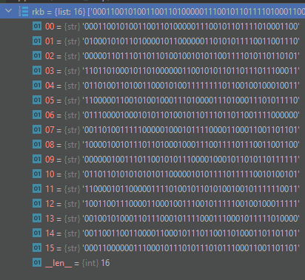
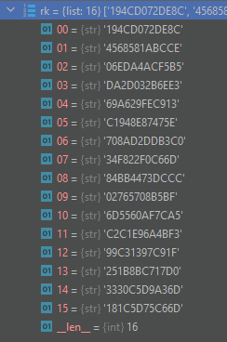
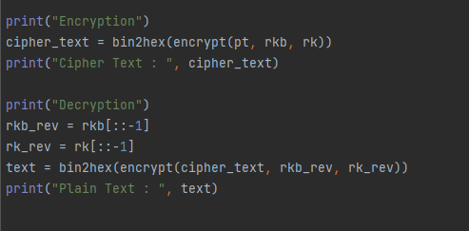
DES: Python Code Review: Encryption

Slide 29
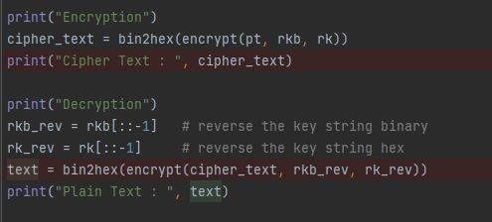
DES: Python Code Review: Decryption
If the string was '1234'
The reverse would be '4321'
Use the same encrypt method for decrypt

Slide 30
DES: Works Cited
Data Encryption Standard (tutorialspoint.com)
Data encryption standard (DES) | Set 1 - GeeksforGeeks
https://simple.wikipedia.org/wiki/Substitution_box

